Slide 1
MAW Website
WIP
Be a Star

Slide 2
Reference sites:
For Animation of Constellation http://lambda-structure-design.jp/
For Cloud movement and design ( to be further discussed with front end programmer) http://www.drinksmartwater.com/#/explore-the-sky

Slide 3
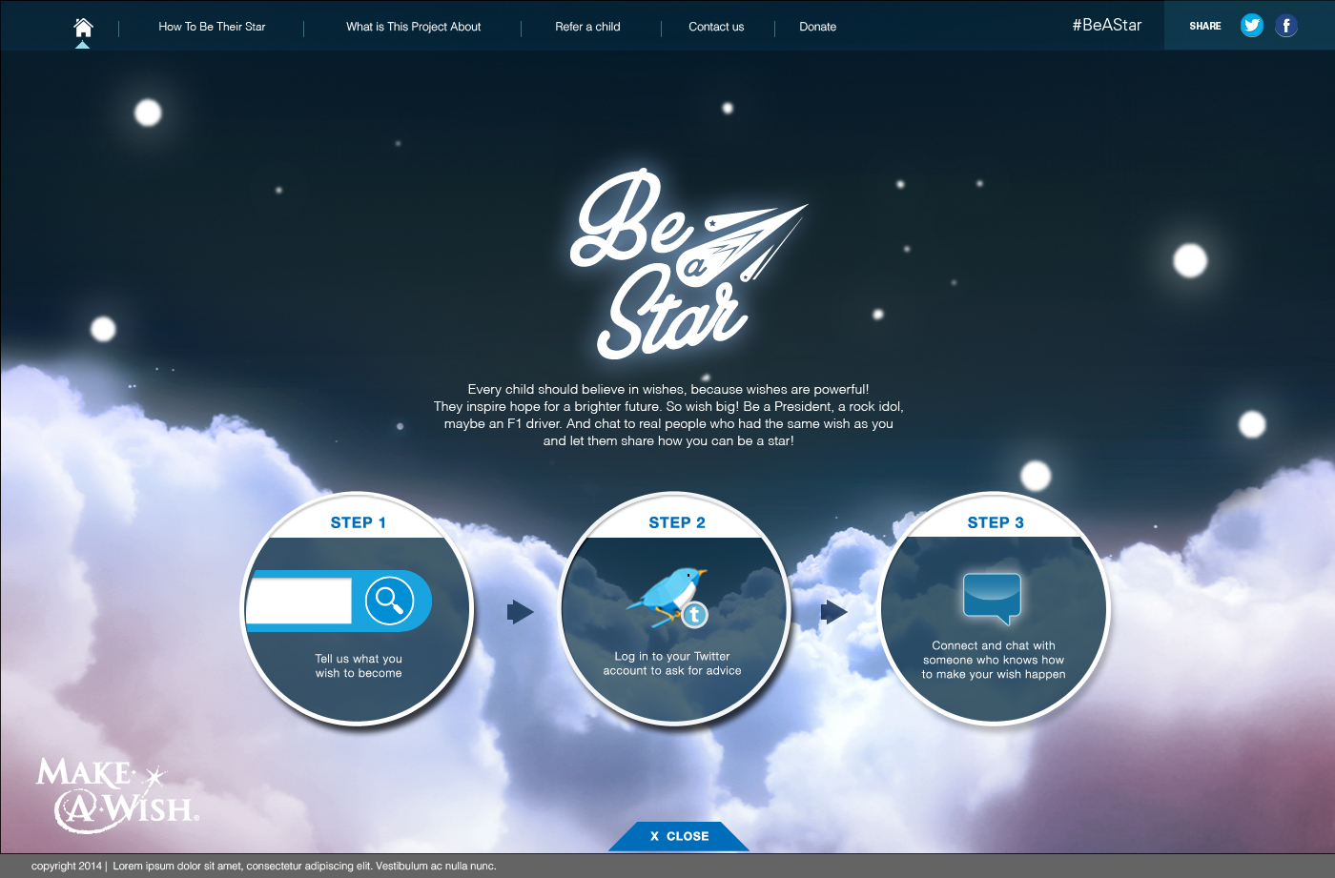
Kids route
Intro/instruction page

Slide 4
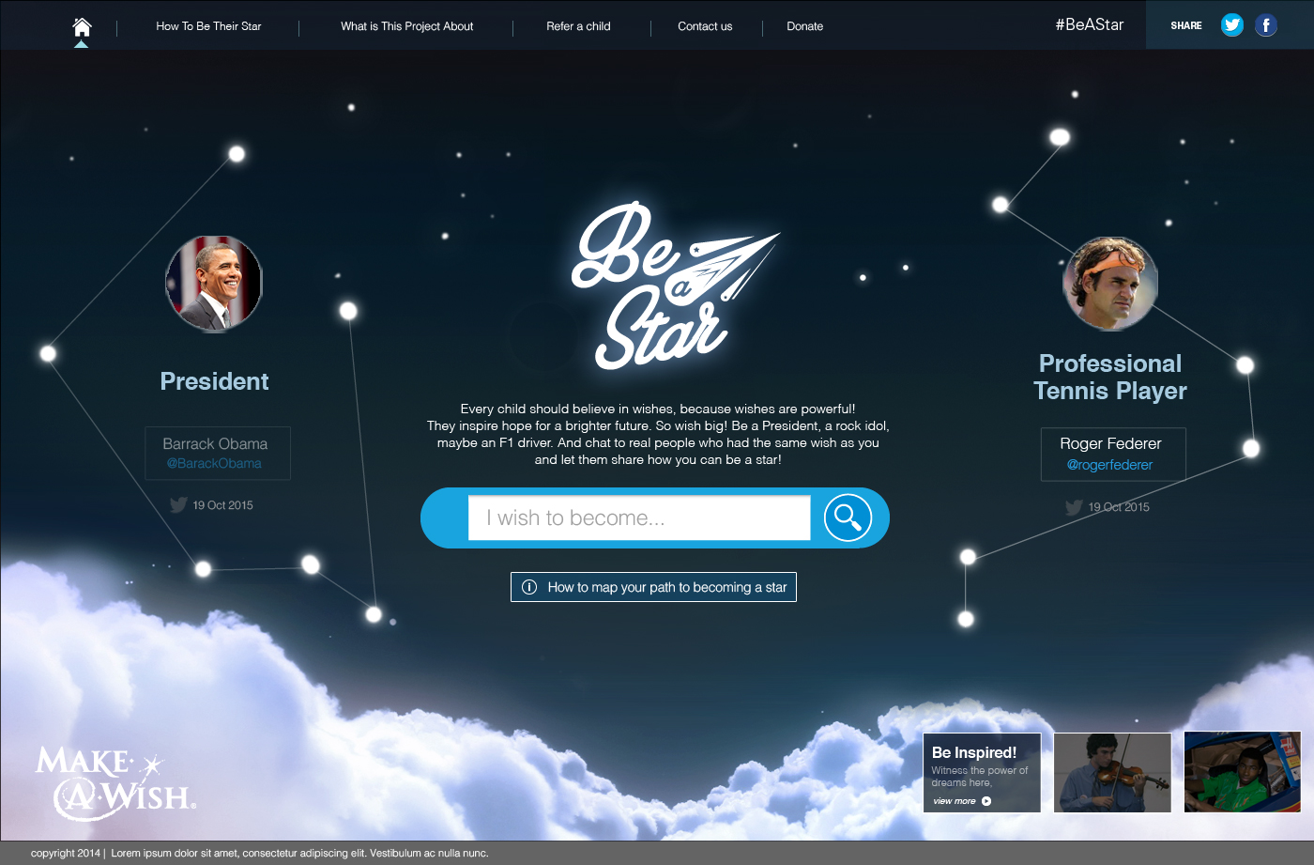
Kids route
Landing page

Slide 5
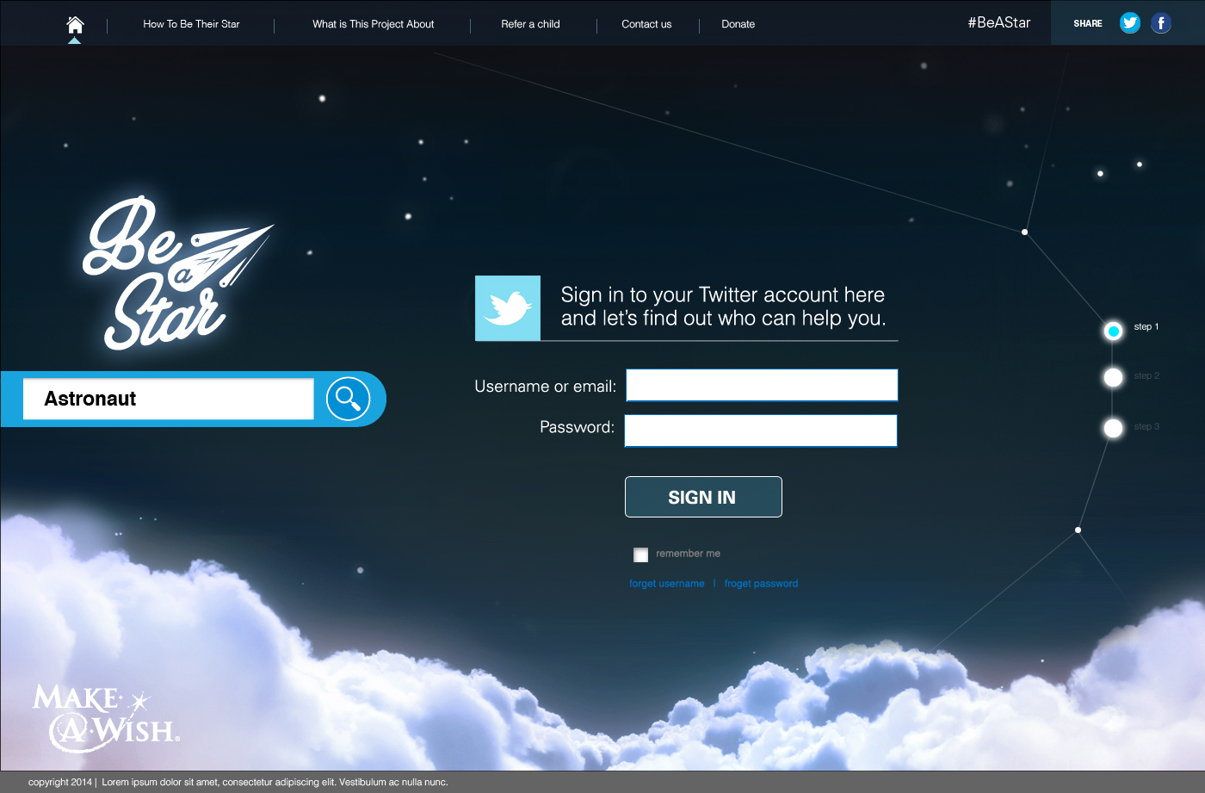
Kids route
Prompted to login

Slide 6
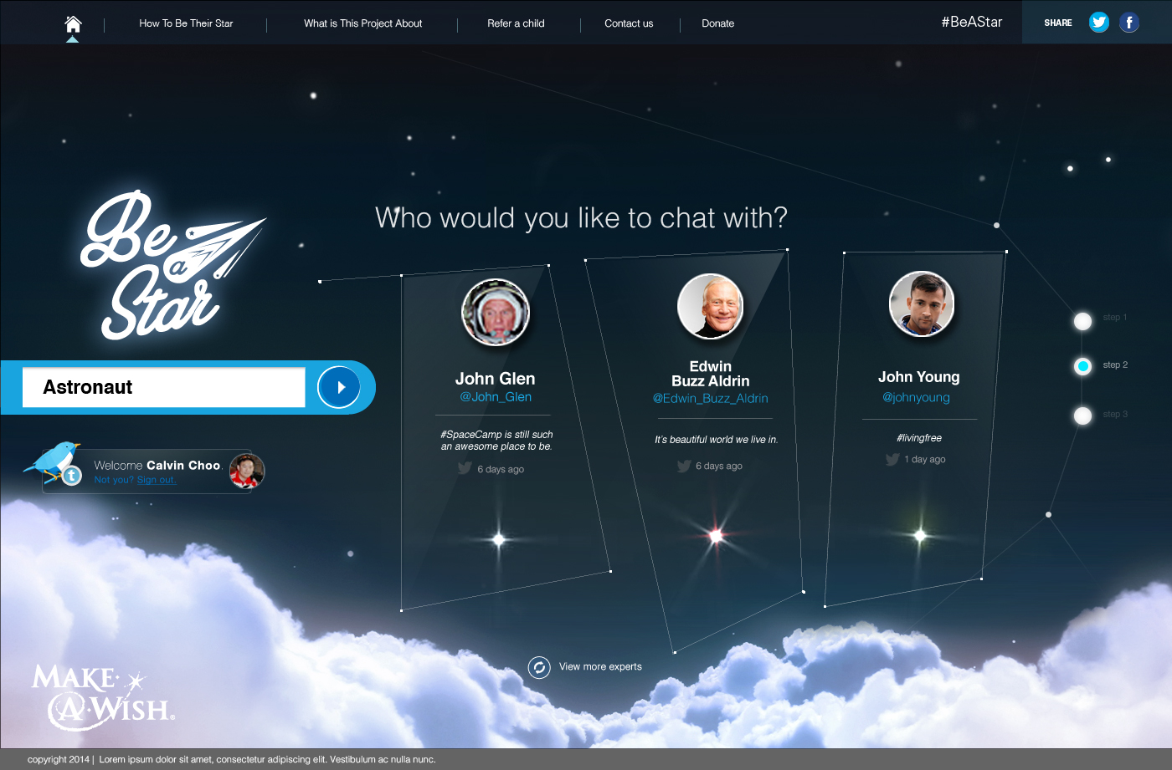
Kids route
Experts panel presented to user

Slide 7
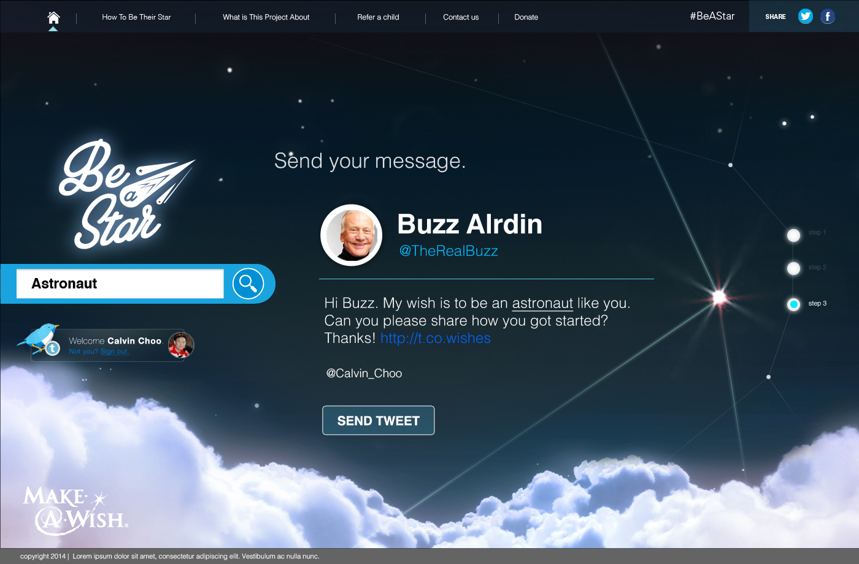
Kids route
Tweet sent the selected expert.

Slide 8
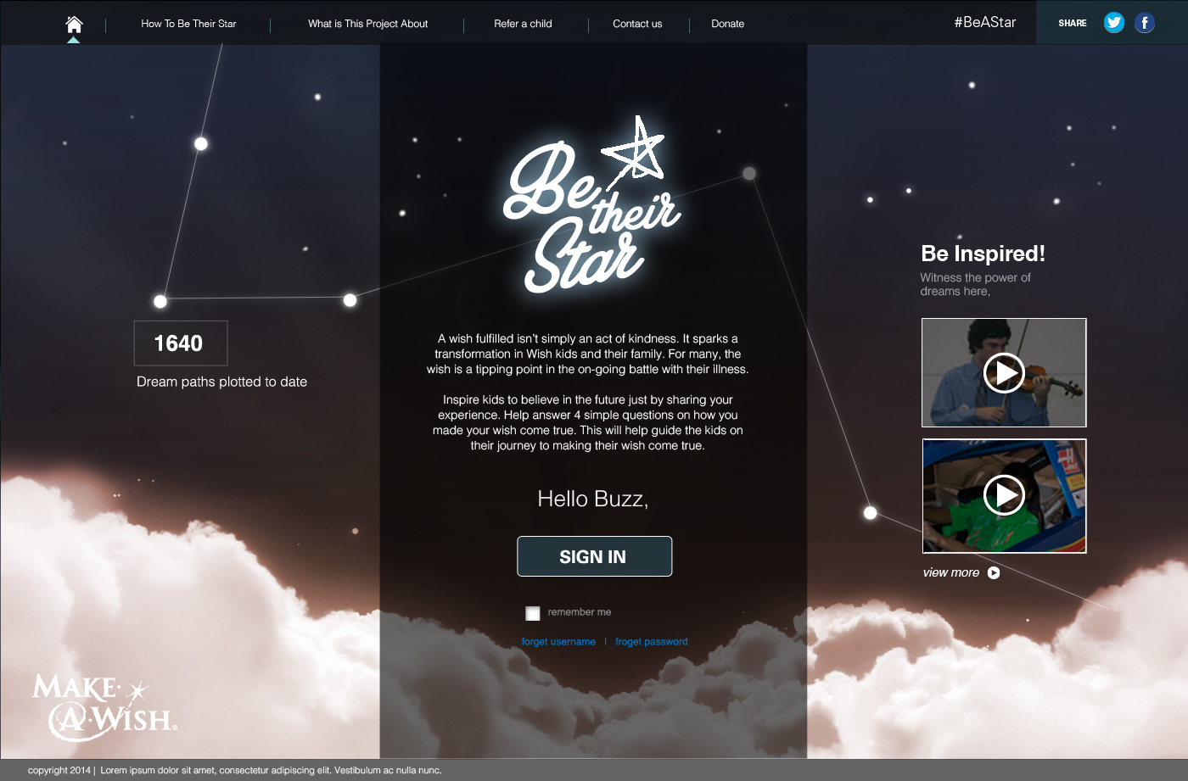
Expert route
Login page for experts.

Slide 9
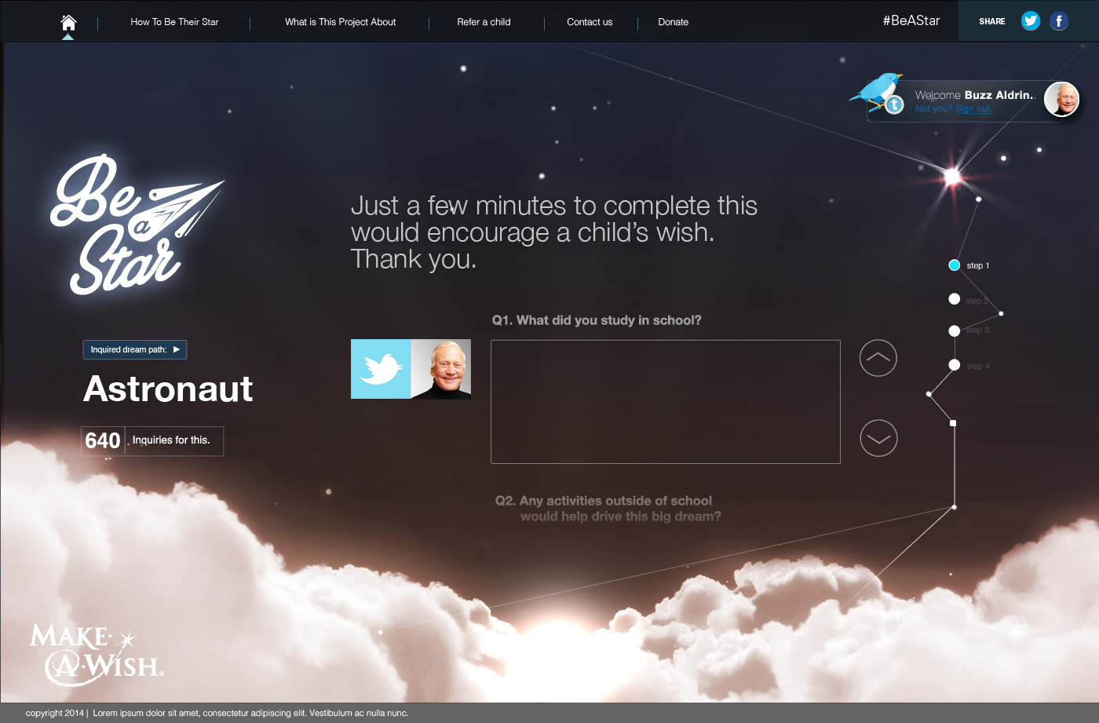
Expert route
Expert brought to enter content

Slide 10
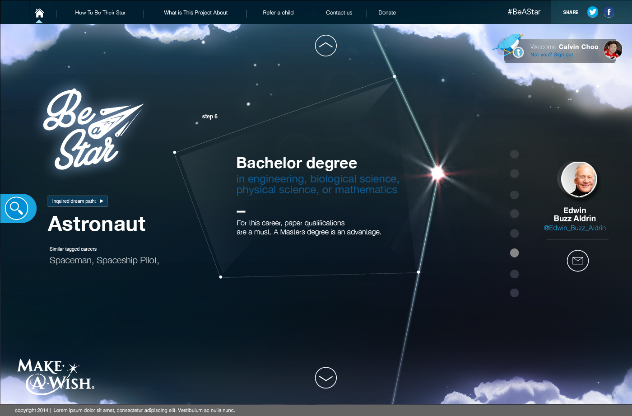
Kids route
Kids noted through a tweet and come see the new dream path

Slide 11
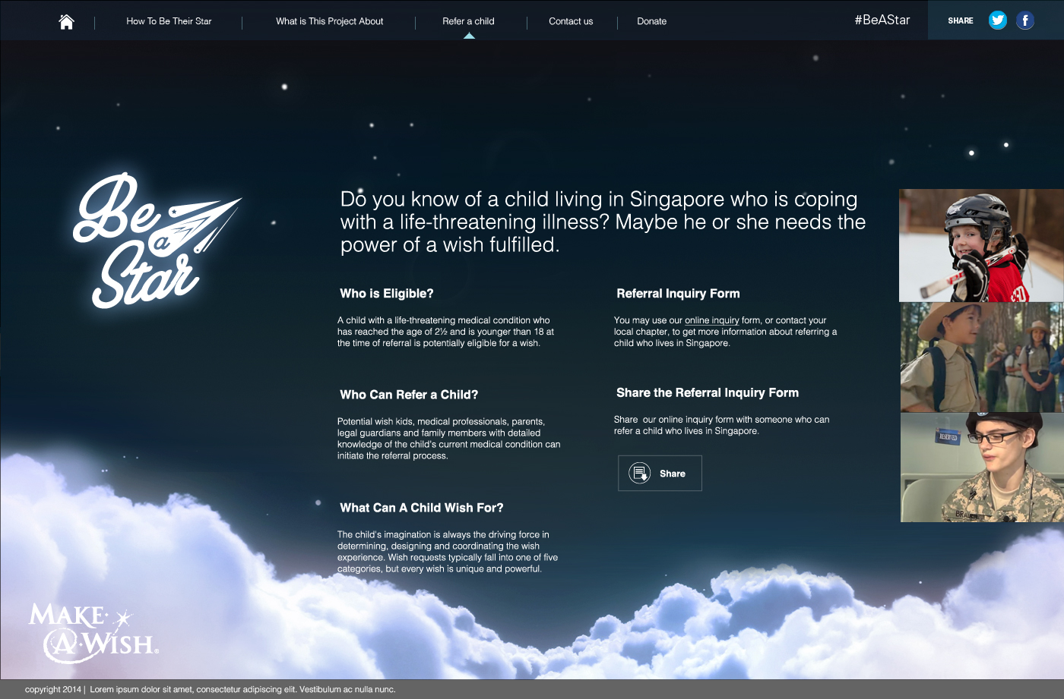
Kids route
Refer a child page

